Slide 1
Service RDC Rollout
Limited Launch
Monday April 2nd 2013

Slide 2
Agenda
Recap & preparation for SVC RDC Launch
Program Schedule
RDCRM/SO001 System transition
Replenishment Schedule
Training & Onsite Support
Q&A

Slide 3
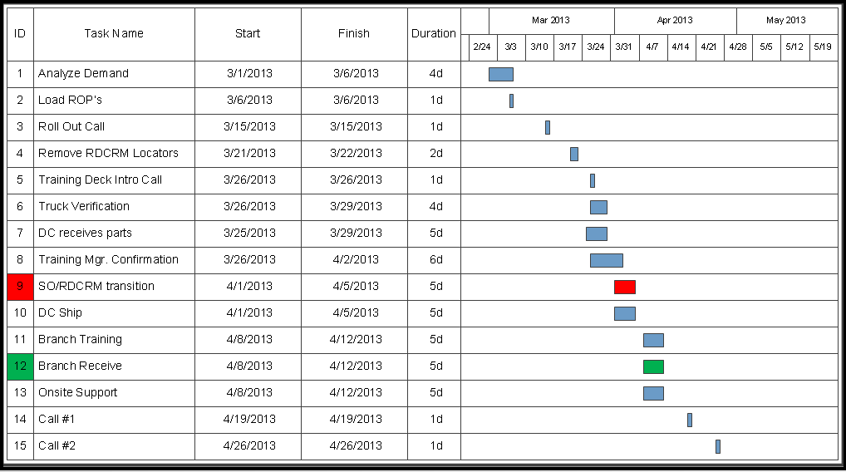

Service RDC Program Schedule
Completed

Slide 4
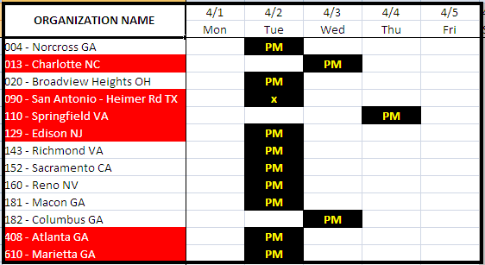
RDCRM / SO Transition
The RDCRM and SO001 will be converted to their future state setups on Tuesday afternoon (4/2)
RDCRM – Automated
SO001 - Manual

Slide 5
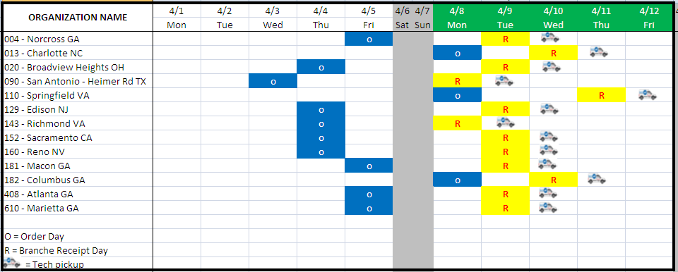
SVC RDC Replenishment Schedule
Review replenishment schedules…
Branches please ensure that all Managers & Team members are aligned with the below Service RDC schedule

Slide 6
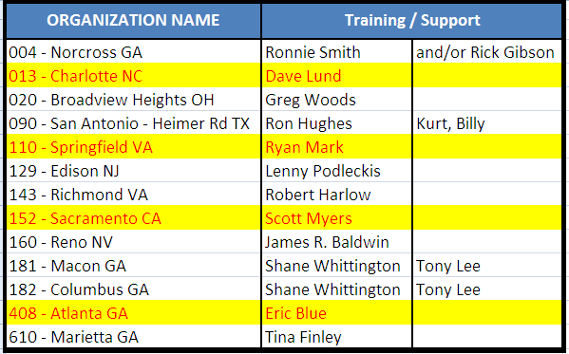
Training / Onsite Support

Slide 7

Questions

